Slide 1
Eosinophilic Esophagitis in Native American Children and Young Adults: A Case Control Study
Bridget Wilson, MD

Slide 2
Publication
Annals of Allergy, Asthma, & Immunology

Slide 3
A Note on Terminology
The American Medical Association Manual of Style suggests that “Native peoples,” “Indigenous peoples,” or “American Indian” are preferred.
However, “Native American” was used in this study because this is how race was documented in the medical record.

Slide 4
Background
Small numbers of Native American patients have been included in studies about eosinophilic esophagitis (EoE)
Previous studies have demonstrated differences in EoE related to other races/ethnicities and age
Purpose:
to compare the history, presentation, and management of pediatric and young adult Native American vs other race patients with
EoE
Notes:
Previous studies have evaluated Black, Hispanic/Latinx, Asian, White and Area deprivation scores

Slide 5
Methods
Single-center, retrospective, case-control study
Patients seen from 2010 to 2024 with EoE
Initially identified by ICD-10 code, K20.0
Only patients meeting EoE consensus guidelines for diagnosis included
Four sex- and current age-matched other race controls per 1 Native American patient
Data collected:
Self-identified race and ethnicity
Clinical and laboratory data from diagnostic and first surveillance esophagogastroduodenoscopies (EGDs)
EoE treatments ever received
Comorbid atopic and gastrointestinal diagnoses
Family medical history

Slide 6
Methods
Statistical Analysis
All-ages analysis and
Age stratified analyses by age at EoE diagnosis
0-4 years old
5-18+ years old
Categorical variables
Odds ratios (ORs) with 95% confidence intervals
Continuous variables
2-sided t tests

Slide 7
Results: Demographics
17 Native American patients
68 Other Race patients
Range of Age at Diagnosis 0-23 years
Similar average age at diagnosis:
Native American: 6.9 years
Other race: 7.7 years
Notes:
Age range for EoE diagnosis was 0 to 23 years

Slide 8
Results: Clinical Features and History
Race/Age | Symptom/Clinical Feature | OR (95% CI)
Native American All Ages | ↑ Current/previous G-tube | 7.07 (1.08-46.34)
 | ↑ H. pylori | 7.07 (1.08-46.34)
 | ↑ No treatment at first surveillance EGD | 7.07 (1.08-46.34)
Native American 0-4 yo | ↑ Family history of atopic dermatitis | 5.63 (1.15-27.44)
Native American 5-18+ yo | ↑ Abdominal pain | 9.33 (1.04-84.2)
 | ↑ Gastroesophageal reflux | 10.67 (1.72-65.99)
 | ↓ Linear furrows | 0.174 (0.03-0.997)
All ages analysis – family history of EoE:
22% other race patients
0 Native American patients
Not statistically significant
0.10 (0.01-1.74)

Slide 9
Results: Diagnostic EGD
Age Group | Esophagus Location | Native American avg eos/hpf +/- SD | Other Race avg eos/hpf +/- SD | Significance P-value
0-4 yo | Proximal | 61.56 +/- 37.37 | 29.27 +/- 30.56 | 0.01
5-18+ yo | Distal | 22.25 +/- 18.36 | 44.11 +/- 26.93 | 0.04
 | Peak | 29.75 +/- 19.36 | 64.14 +/- 28.16 | 0.002
Average number of months from diagnostic to surveillance EGD in 5-18+ year olds:
Native American: 11.29 months
Other Race: 4.94 months
Not statistically significant
P=0.31

Slide 10
Results: Treatment
No statistically significant differences in EoE treatments ever received:
Proton pump inhibitors
Swallowed corticosteroids
Dupilumab
Dietary elimination

Slide 11
Conclusion
This is the largest cohort of Native American patients with EoE described
Race-related and age-dependent differences were identified in this study
However, this is a single study of a relatively small number of patients, so there should be caution in generalizing these results broadly
Due to small sample size, unable to perform multivariate regression to control for confounding variables
Future research:
Prospective, multicenter studies with larger numbers of patients
Geographic information
Addressing potential disparities and barriers to EoE diagnosis and care

Slide 12
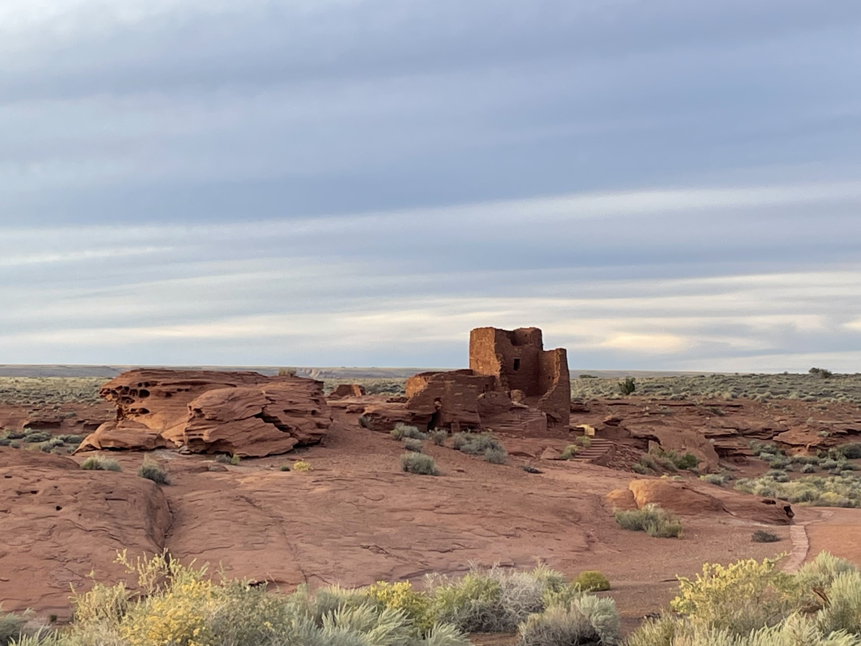
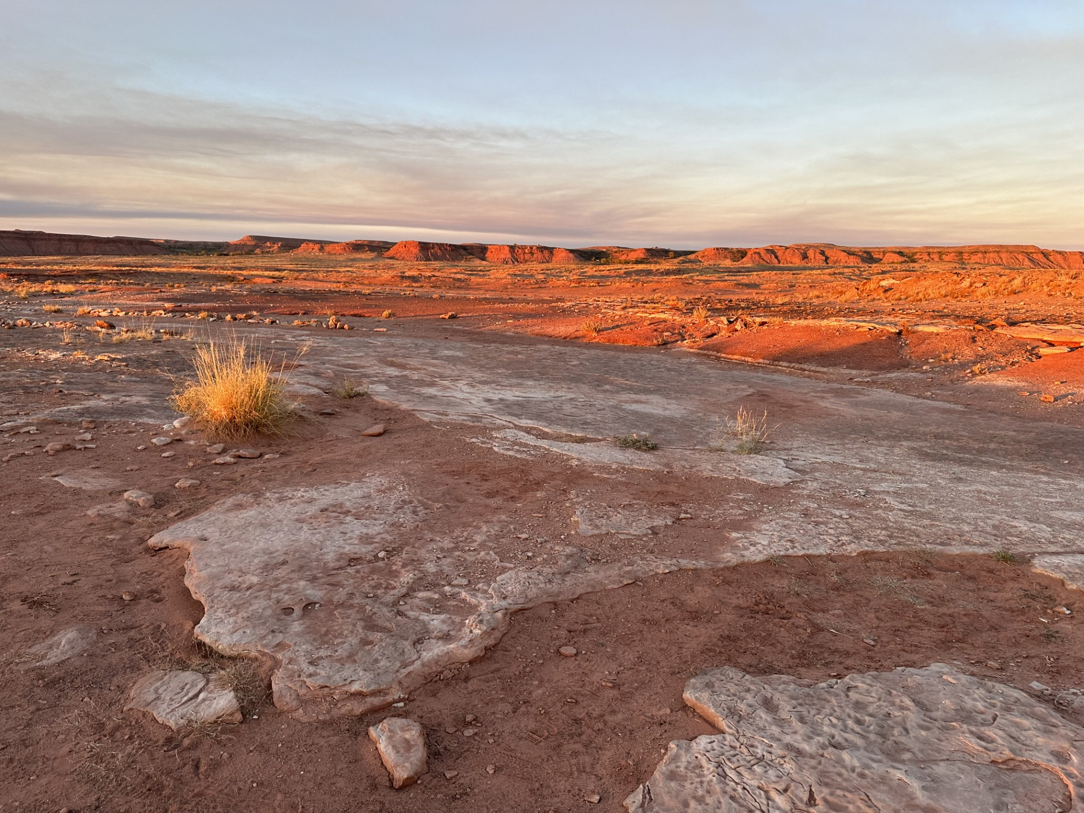
Questions and Discussion

