Slide 1
CEGIR Diversity Presentation
March 22, 2023
Pooja Mehta MD, MSCS

Slide 2
Methods
Selected Black children with EoE aged 1-17 years old seen in 2 urban clinics from 2010-2018
Age/sex matched Non-Black children with EoE during the same time period and retrospectively compared clinical features and outcomes

Slide 3
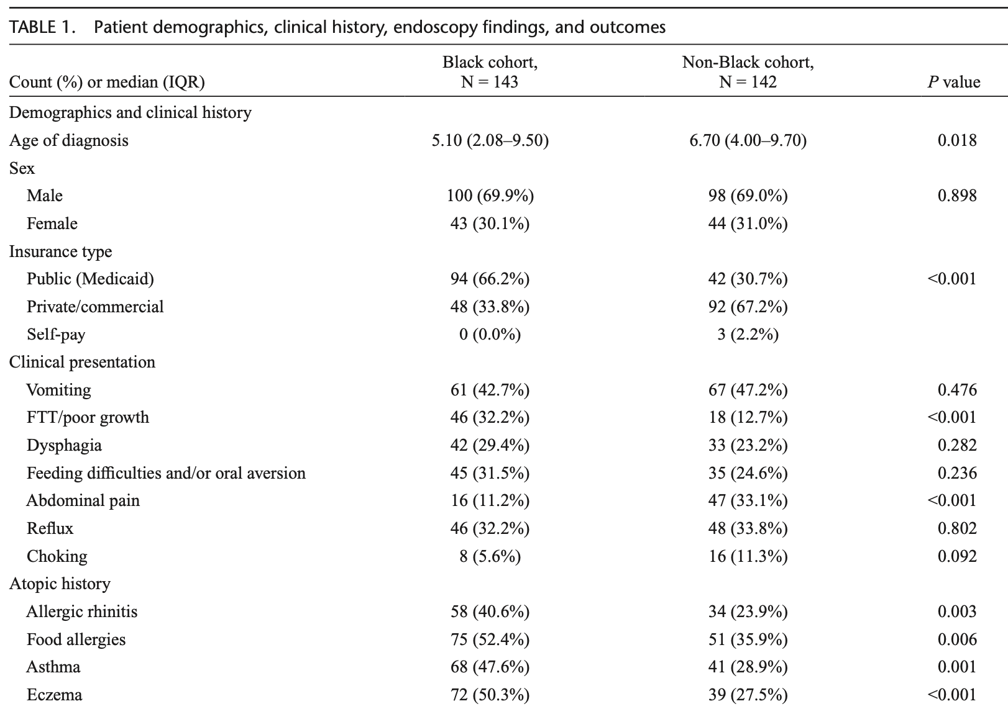

Slide 4
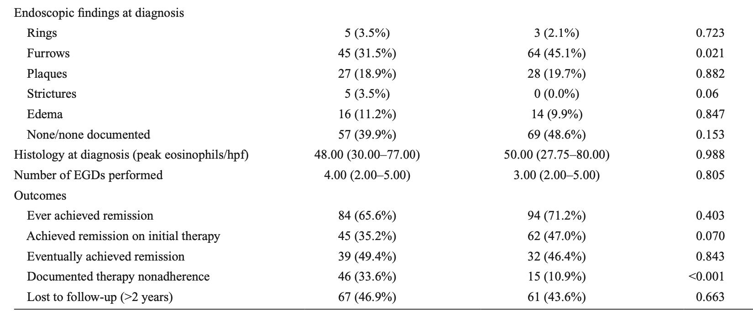

Slide 5
Authors conclusions
“Overall, there were some important differences between our two cohorts, suggesting black patients may present with more severe symptoms or have issues with access to care.”
“Medication nonadherence was greater in our black cohort.”

Slide 6
What is the relationship between race and medication adherence?

Slide 7
How do we assess adherence in EoE and why does race play a role?
It seems that the authors assessed adherence via chart review.
Is this accurate?

Slide 8
Using machine learning, these researchers examined over 40,000 H&Ps/progress notes from over 18,000 patients
Black patients had 2.54 times the adjusted odds of having one or more negative descriptors in the EHR compared with White patients
Most common negative descriptors: “refused,” “not-adherent,” “not-compliant,” and ”agitated”
Patients with Medicaid (had higher adjusted odds (OR: 2.66) of a negative descriptor compared with patients with private or employer-based insurance

Slide 9
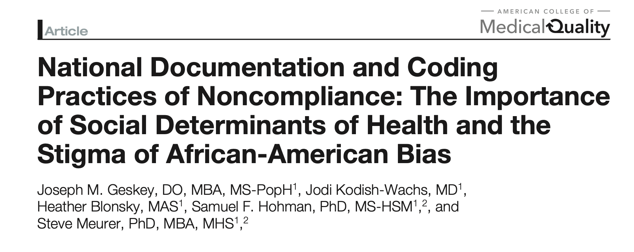
Looked at “noncompliance” Z-codes and compared them to social determinants of health over greater than 1,000 hospitals and nearly 9 million inpatient admissions

Slide 10
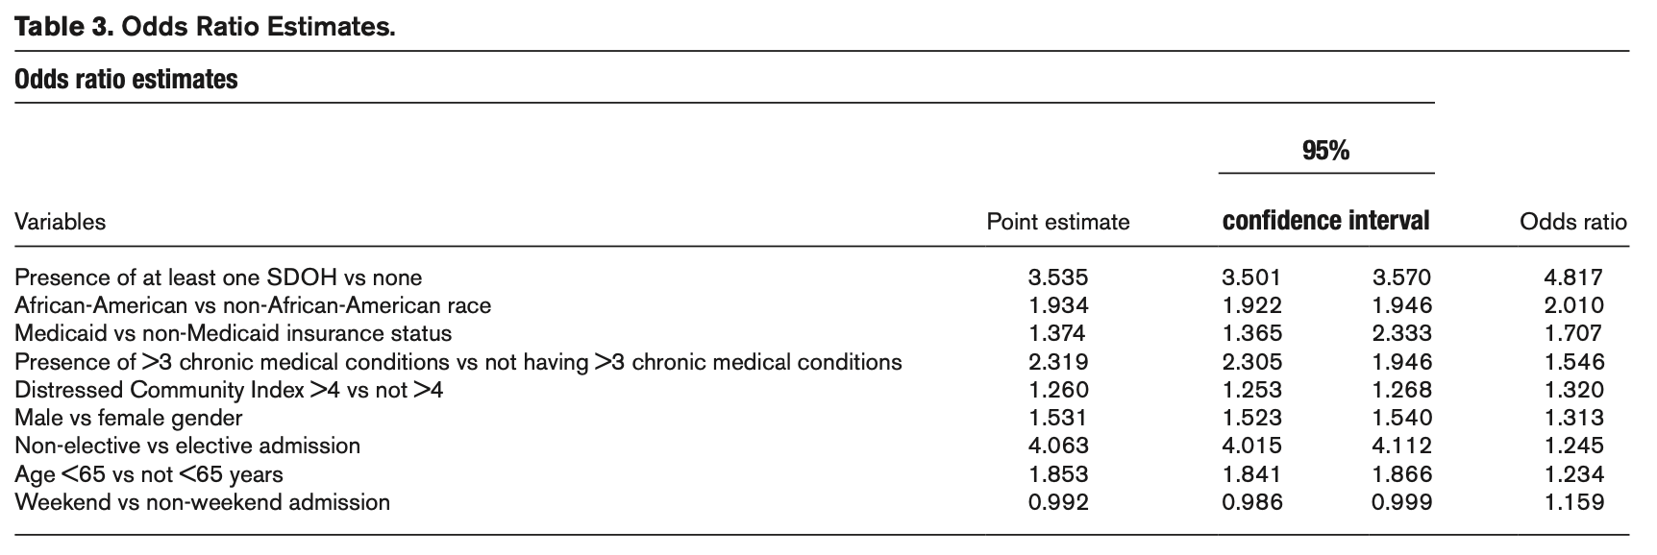

Slide 11
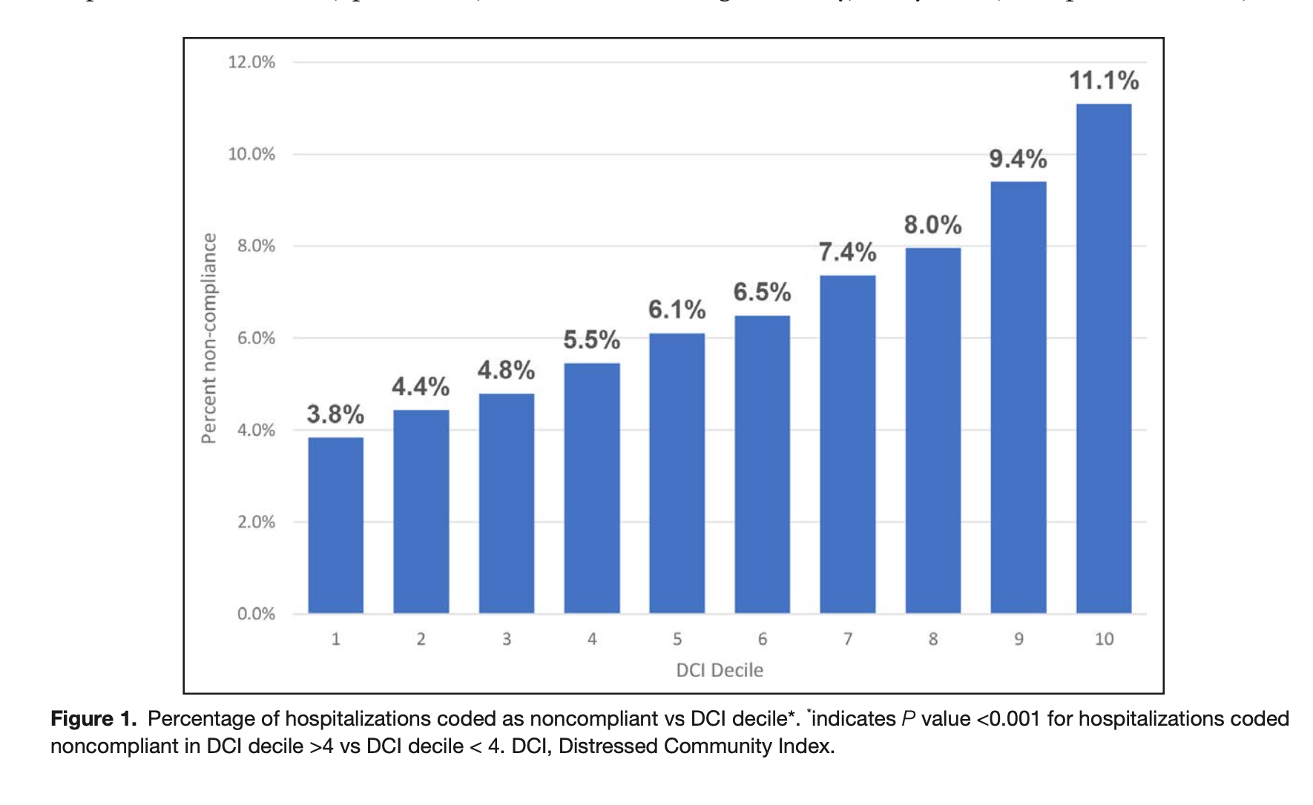

Slide 12
Other factors relevant to adherence
Many studies have found that patients from marginalized communities have greater negative beliefs regarding medications and less trust in medicine based on the complex interrelationship between social conditions and historical experiences.
Patient-Physician interaction including negative effects of implicit bias and positive effects of race concordance of prescribing physician
Higher rates of poverty experienced Black and Hispanic patients due to systematic inequalities over decades.
Shavers VL, Lynch CF, Burmeister L, Annals of Epidemiology, 2002
Shen MJ et al. J Tacial Ethn Health Disparities. 2018
McQuaid EL. Annals of Allergy, Asthma, & Immunology. 2018.

Slide 13
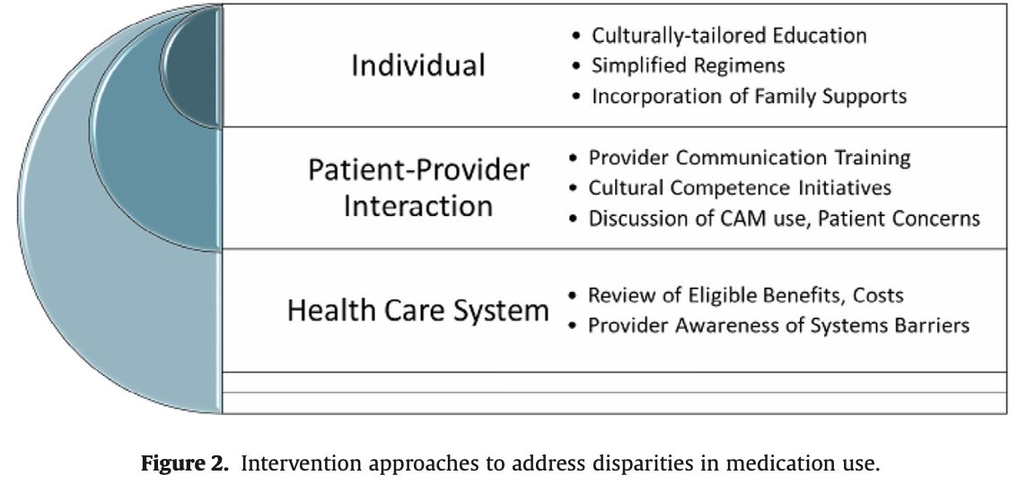
Where do we go from here?
Take home point: when addressing medication adherence, its important to know that it is incredibly intertwined with other social determinants of health and disparities experienced by marginalized communities
McQuaid EL. Annals of Allergy, Asthma, & Immunology. 2018.

