Slide 1
Increasing the diversity of research populations
Amy Klion
May 24, 2023

Slide 2
Clinical trial enrollment does not reflect the diversity of the US population
Black/African American individuals represent 14.2% of the US population, but comprise only 5% of clinical trial participants
Approximately 1/5 of the US population is of Hispanic or Latino heritage, but Hispanic and Latino individuals comprise only 1% of trial enrollment
Underrepresentation of these communities affects the generalizability of data from clinical trial

Slide 3
The reasons for these disparities are complex
Mistrust of researchers and medical institutions
Lack of awareness of clinical trials
Financial constraints
Logistical burdens
Limited access to study opportunities
…

Slide 4
Study Aim
To demonstrate how best practices in multicultural and multilingual awareness can increase minority enrollment using the Passive Immunity Trial for Our Nation (PassITON) as an example

Slide 5
What methods can be used to enhance awareness?
Cultural tailoring of content using community specific statistics and racially concordant images and leveraging community values and belief systems to shape the message
Use of easy to understand, plain language on study materials to overcome education and comprehension challenges (“health literacy”)
Translation of study materials where appropriate using “transcreation” (translations that preserve message, tone and emotion and take into account cultural nuances)
Using multiple communication channels, including social media, broadcasting, healthcare workers,… to target different populations
Community outreach through engagement of community leaders, focus groups, town halls, religious institutions,….

Slide 6
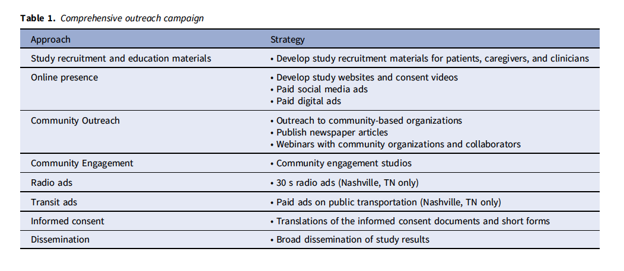
The PassITON trial
A randomized controlled trial of the efficacy of convalescent plasma for adults hospitalized with COVID-19 at 25 centers
Contracted with the marketing firm Culture Shift Team to increase URM enrollment

Slide 7
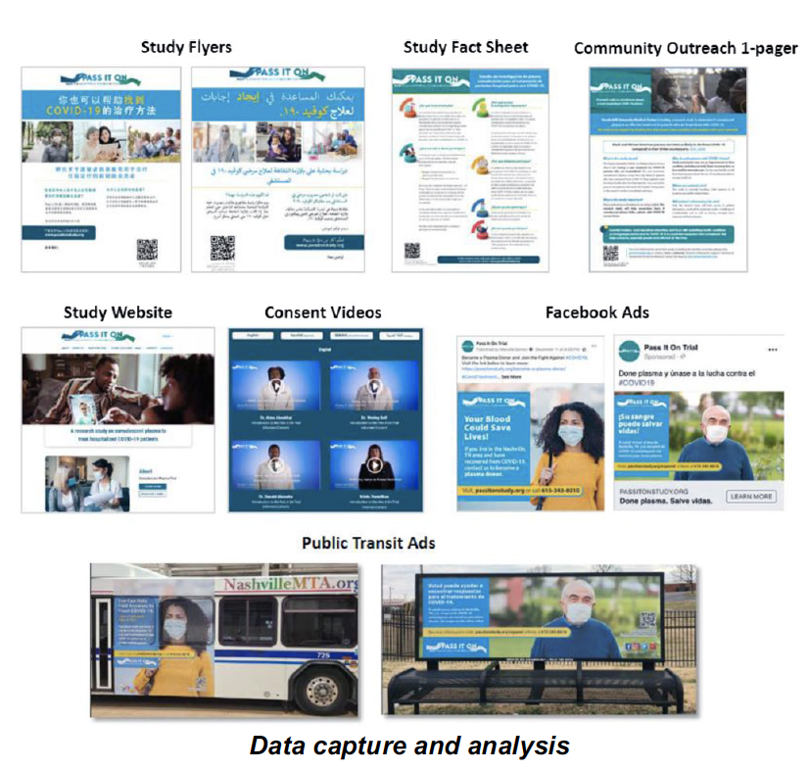
Study materials
All written and video study materials were available in English, Spanish, Chinese and Arabic
Ad placement was filtered to target zip codes within 50 miles of participating sites with URM populations >10% and high rates of COVID-19
Digital ads were used as banner advertisements on 30 select English and Spanish websites

Slide 8
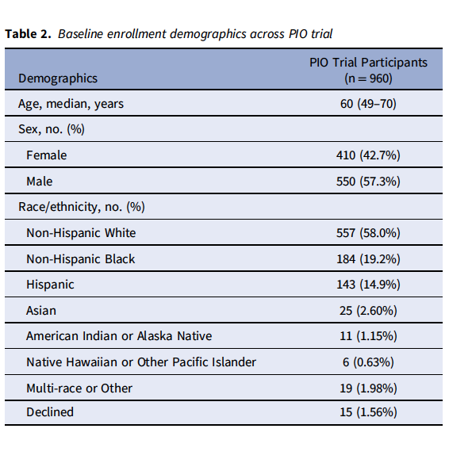
Results

Slide 9
Conclusions
Enhancement of diversity in clinical trials is possible
Despite some obvious differences between PassITON and trials in rare diseases, many of the suggested approaches could be implemented in CEGIR trials

