Slide 1
CEGIR Diversity, Inclusion and Equity Committee Updates
Glenn Furuta, Children’s Hospital Colorado
Dominique Bailey, Columbia University Irving Medical Center
Amanda Muir, Children’s Hospital of Philadelphia
August 25, 2021

Slide 2
Accomplishments (2020-2021)
CEGIR Diversity Committee
DEI Reference Manager (Sciwheel)
Diversity Corner (CEGIR Website)
Educational Resources
JACI “Reply to Author”
Vision & Mission Statements
CEGIR All Call Presentations
Mission Statement- We will develop an understanding of cultural, ethnic and racial diversity and structural racism, particularly as it pertains to underrepresented populations of patients with eosinophilic gastrointestinal diseases (EGIDS); strive to examine systemic and implicit biases; identify associated barriers to our research; and integrate the knowledge into our research studies and educational initiatives, so that we can better serve all patients with EGIDs.
Vision Statement - CEGIR actively promotes a culture of diversity and inclusivity in its membership, in its innovative research studies and its educational initiatives.
Notes:
In July 2020, in response to longstanding, systemic racial, cultural and gender injustices that have affected health care delivery, CEGIR developed a committee to focus on diversity and inclusion in our research and education activities. These efforts intend to improve the care for underrepresented populations with EGIDs.
We hold true to our mission and vision statements--- We will develop an understanding of cultural, ethnic and racial diversity and structural racism, particularly as it pertains to underrepresented populations of patients with eosinophilic gastrointestinal diseases (EGIDS); strive to examine systemic and implicit biases; identify associated barriers to our research; and integrate the knowledge into our research studies and educational initiatives, so that we can better serve all patients with EGIDs.
During the past year, we established CEGIR Diversity, Inclusion and Equity Reference Manager using the Sciwheel platform. Sciwheel allows the all CEGIR members to access and upload articles related to diversity, equity and inclusion. This reference manager will be used to highlight sentinel articles on the CEGIR ALL call meetings and postings to the CEGIR website in order to educate the community at large.
We also established the Diversity Corner of the CEGIR Website which highlights ALL Call presentations, journal articles of interest and more to come
In addition we have been able to share complementary diversity educational materials to CEGIR members. Including the UAB NORC Minority Symposium thanks you to Dr. Frank Hamilton for sharing this opportunity with us. The seminars were a forum designed for underrepresented groups in academia, mentors, and advocates to identify barriers and discover strategies to a successful career in academia. We were also able to share another educational opportunity through the AGA GI Forging FORWARD Program that focused on minority recruitment in clinical trials that we hope to learn best practices to apply in recruitment efforts within CEGIR.
“Reply to Author”- Amanda to present

Slide 3
Future Directions (2021-2022)
CEGIR Diversity Committee
DEFINE Study
CEGIR Diversity Wheel Workshop
Systematic Review
Insert your idea here
Ongoing Diversity Committee Projects:
CEGIR Reference Manager
CEGIR Diversity Corner
https://www1.rarediseasesnetwork.org/cms/cegir/News-Spotlights-Events
Educational Resources/Guest Speakers
CEGIR All Call Presentations
Notes:
DEFINE Study- Amanda to present
Systematic Review - Elizabeth to present
CEGIR Diversity Wheel Workshop- Dominique to present

Slide 4
Diversity Wheel Workshop Agenda Date/Time: TBD
Welcome and Agenda Review
Diversity Wheel Presentation
Description of Breakout Sessions
Breakout sessions
Breakout session 1: Adapting the Diversity Wheel to EGID
Breakout session 2: Incorporating the EGID Diversity Wheel into Clinical Trial Design and Implementation
Breakout facilitator present output from discussion
Concluding Remarks and Thank You
Notes:
Please email Heidi if you are interested in attending.

Slide 5
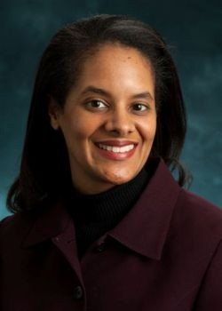
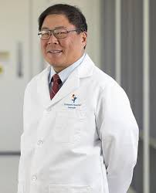
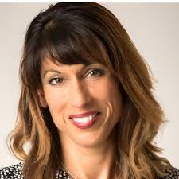
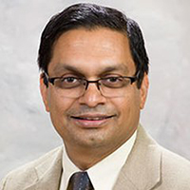
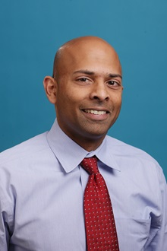
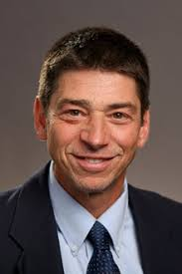
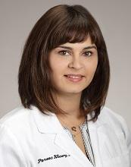
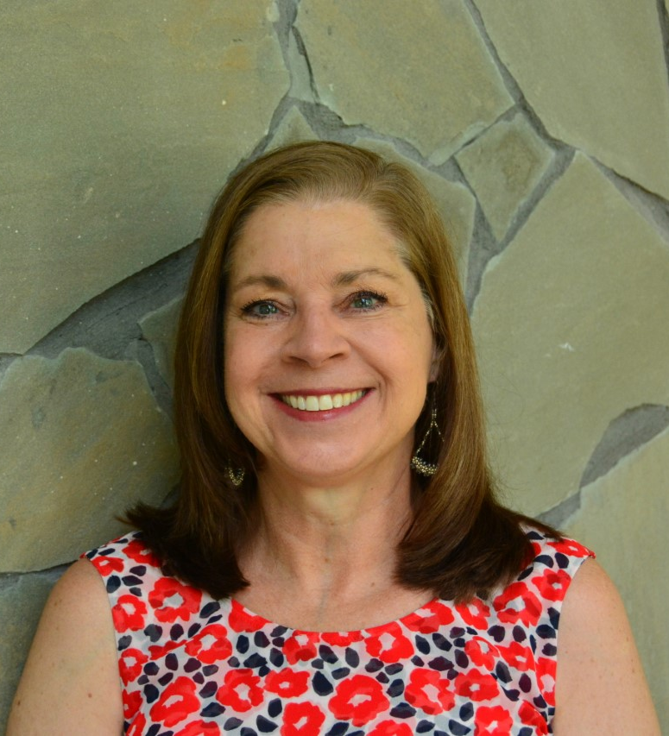
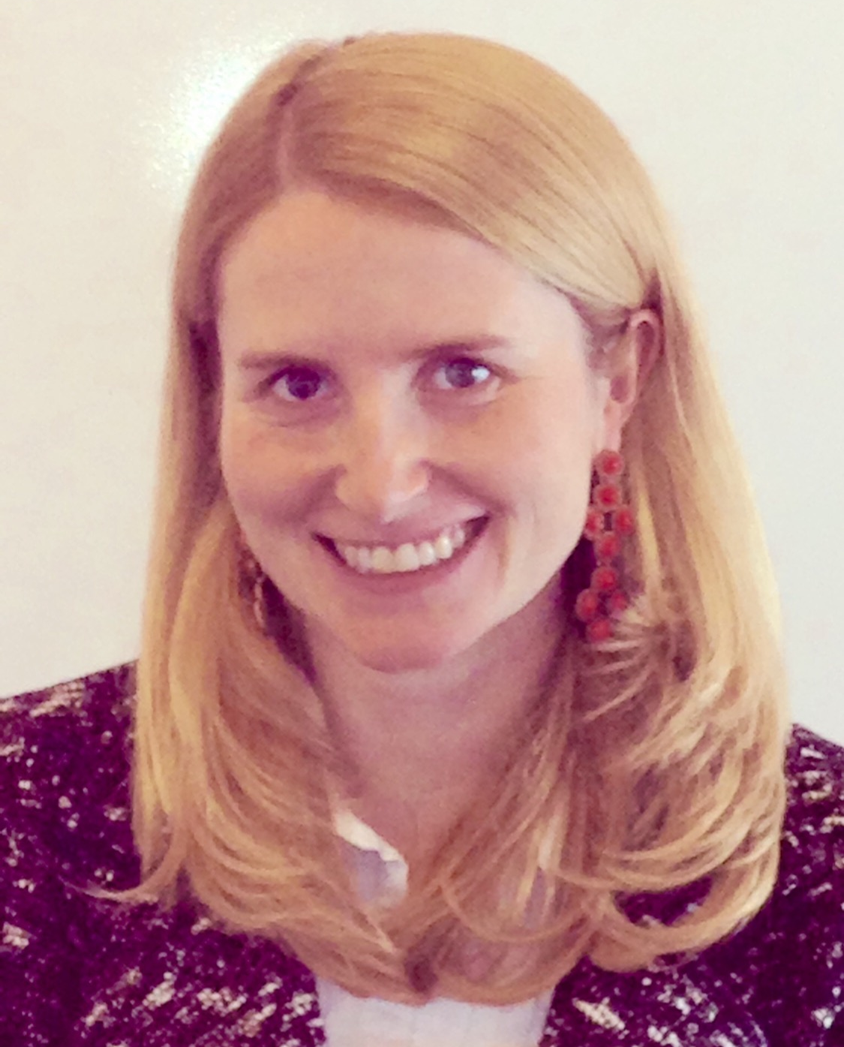
CEGIR Diversity, Inclusion and Equity Committee
Pablo Abonia
Seema Aceves
Dominique Bailey
Mirna Chehade
Margaret Collins
Carla Davis
Evan Dellon
Gary Falk
Glenn T. Furuta
Sandeep Gupta
Elizabeth Jensen
Amy Klion
Dawn McCoy
Paneez Khoury
Amanda Muir
Vincent Mukkada
Marc Rothenberg
Kathleen Sable
Melissa Scott
Joshua Wechsler
Benjamin Wright
Amy Zicarelli
Notes:
These are the current CEGIR Diversity committee members- and we invite anyone else who is interested and we welcome new and innovative ideas.
Please email Amanda or myself if you are interested in joining.
Thank you so much for your time and attention.

